Slide 1

Management Information Systems: Managing the Digital Firm
Seventeenth Edition, Global Edition
Chapter 11
Managing Knowledge and Artificial Intelligence
Copyright © 2022, 2020, 2018 Pearson Education, Ltd. All Rights Reserved
Notes:
If this PowerPoint presentation contains mathematical equations, you may need to check that your computer has the following installed:
1) MathType Plugin
2) Math Player (free versions available)
3) NVDA Reader (free versions available)

Slide 2
Learning Objectives
11.1 What is the role of knowledge management systems in business?
11,2 What are artificial intelligence (AI) and machine learning? How do businesses use AI?
11.3 What types of systems are used for enterprise-wide knowledge management, and how do they provide value for businesses?
11.4 What are the major types of knowledge work systems, and how do they provide value for firms?
11.5 How will M I S help my career?
Notes:
The purpose of this chapter is to discuss the business value of knowledge and describe how knowledge is created and managed in the firm. For most students, the idea of business being dependent on knowledge will be a new idea. You might ask students to come up with definitions of knowledge and to distinguish knowledge from data, information, and wisdom. Give examples of types of organizations (hospital, law firm, car dealership, diner, school, etc.) and ask students to come up with specific examples of knowledge that would be important to that organization.
This chapter is also about artificial intelligence and how it used in firms and organizations to improve decision making. The Grand Vision of AI where machines are as smart as humans is contrasted with a more realistic view of AI where machine learning and other AI techniques are useful in discovering patterns in large data sets and can assist managers in understanding their business and environment.

Slide 3
Video Cases
Case 1: How I B M’s Watson Became a Jeopardy Champion
Case 2: Alfresco: Open Source Document Management and Collaboration

Slide 4
Artificial Intelligence Beats Radiologists in Reading Mammograms (1 of 2)
Problem
  High level of information inaccuracy
  Opportunities from new technology
Solutions
  Monitor accuracy and costs
  Evaluate study results
  Collect mammograms for system training and testing
  Train pattern recognition system
  Compare AI system and human radiologist findings
  AI pattern recognition system

Slide 5
Artificial Intelligence Beats Radiologist in Reading Mammograms (2 of 2)
Demonstrates how organizational performance can benefit from using technology such as artificial intelligence to facilitate acquisition and application of knowledge
Illustrates the ability of AI pattern recognition systems to achieve higher level of accuracy than human radiologists

Slide 6
What is the Role of Knowledge Management Systems in Business?
Knowledge management systems among fastest growing areas of software investment
Information economy: production and distribution of information and knowledge a major source of wealth and prosperity
Substantial part of a firm’s stock market value is related to intangible assets: knowledge, brands, reputations, and unique business processes
Well-executed knowledge-based projects can produce extraordinary R O I
Notes:
This slide emphasizes the role of knowledge today in the U.S. economy. Ask students to give examples of knowledge and information sectors (finance, publishing, etc.).

Slide 7
Important Dimensions of Knowledge (1 of 2)
Data, information, knowledge, and wisdom
Tacit knowledge and explicit knowledge
Important dimensions of knowledge
  Knowledge is a firm asset
  Knowledge has different forms
  Knowledge has a location
  Knowledge is situational
Notes:
This slide and the next begin to answer the question “What is knowledge” as it pertains to the organization. Ask students to distinguish among data, information, knowledge and wisdom.
Ask students why it is important to define and describe knowledge. Ask students to provide examples of knowledge, given an example industry, that illustrate that it is a “firm asset”. (E.g., For an electrical appliances firm, knowing how to make the most efficient and cheapest air conditioner). Ask students to explain each element of the dimensions, providing examples. For example, what is meant by “knowledge is intangible”, “Give me an example of explicit knowledge,” and so on.
Ask students to further explain or give examples for each characteristic. For example, “What is an example of knowledge with a social basis?” “What is an example of knowledge that is sticky; what is sticky about it?”

Slide 8
Important Dimensions of Knowledge (2 of 2)
Knowledge-based core competencies
  Key organizational assets
Knowing how to do things effectively and efficiently in ways others cannot duplicate is a prime source of profit and competitive advantage
  Example: Having a unique build-to-order production system
Organizational learning
  Process in which organizations gain experience through collection of data, measurement, trial and error, and feedback
Notes:
This slide emphasizes the value of knowledge to the organization. Give examples of well-known companies and ask students to describe knowledge the company has that gives it competitive advantage, such as Apple, eBay, Burger King, and so on. It might also be a good time to point out what is the value of a “skilled labor force.” That value results from the knowledge employees have to do their jobs efficiently and effectively. This knowledge in the heads of employees is hard to replace.
This slide also introduces the concept of organizational learning, which describes the process of gathering, creating, and applying knowledge. Most students will be surprised that organizations learn, and others will provide many examples of organizations which refused to learn anything. In organizational learning, knowledge becomes the driver of new behavior—decision making, new products and services, new business processes. This might be seen also as organizations sensing and responding to their environment. Give the students examples of organizations, such as a school, hospital, bank, clothing manufacturer, and ask them to provide examples of how that business might demonstrate organizational learning.

Slide 9
The Knowledge Management Value Chain (1 of 3)
Knowledge management
  Set of business processes developed in an organization to create, store, transfer, and apply knowledge
Knowledge management value chain
  Each stage adds value to raw data and information as they are transformed into usable knowledge
    Knowledge acquisition
    Knowledge storage
    Knowledge dissemination
    Knowledge application
Notes:
This slide defines the term knowledge management and describes the process from acquiring knowledge to applying it as a value chain and is followed by slides detailing each stage. Each stage of the chain adds more value to the raw data and information. Ask the students to differentiate between the stages, and how each stage could incorporate more value? For example, how does knowledge once it is stored incorporate more value than the previous stage, knowledge that is being acquired?

Slide 10
The Knowledge Management Value Chain (2 of 3)
Knowledge acquisition
  Documenting tacit and explicit knowledge
    Storing documents, reports, presentations, best practices
    Unstructured documents (e.g., e-mails)
    Developing online expert networks
  Creating knowledge
  Tracking data from T P S and external sources
Knowledge storage
  Databases
  Document management systems
  Role of management
Notes:
This slide discusses the first and second stages of the knowledge value chain: knowledge acquisition and knowledge storage. It describes the different ways in which knowledge can be acquired as well as describing the ways in which knowledge is stored. It also notes the importance of management in creating and maintaining repositories of knowledge. Give the students an example company, such as a medical practice, and ask what type of knowledge they would need and how it should be stored (e.g., medical records of patients).

Slide 11
The Knowledge Management Value Chain (3 of 3)
Knowledge dissemination
  Portals, wikis
  E-mail, instant messaging
  Search engines, collaboration tools
  A deluge of information
    Training programs, informal networks, and shared management experience help managers focus attention on important information.
Knowledge application
  New business practices
  New products and services
  New markets
Notes:
This slide discusses the third stage of the knowledge value chain and describes various ways that knowledge can be disseminated within the organization. Ask the students for examples of how they received knowledge from a job they have had or a university or college they have attended. What type of knowledge was transferred and what means were used? Were these methods of dissemination adequate or do they see more effective ways to disseminate the same information? How can a company or its employees have “too much information”?
This slide also discusses the last stage of the knowledge value chain, knowledge application, and emphasizes the need to see and evaluate knowledge in terms of organizational capital and return on investment. Ask the students if they have any examples from their own experience in education or work of how new knowledge can result in a new business practice, new product, or new market.

Slide 12
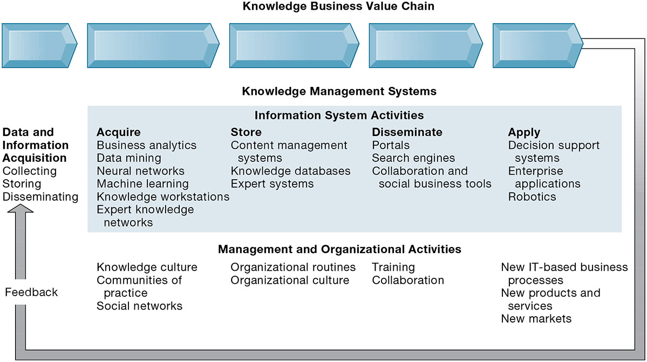
Figure 11.1 The Knowledge Management Value Chain
Notes:
Figure 11.1, Page 421.
Knowledge management today involves both information systems activities and a host of enabling management and organizational activities.
This graphic details the stages of the knowledge management value chain, separating the information system activities from the management/organizational activities involved at each stage. It also describes two other very important requirements for the value chain, the initial data and information acquisition that forms the basis for creating knowledge, and feedback from the knowledge application stage that can result in new opportunities for data and knowledge creation.
Alt Text
Long description: An illustration explains the role of knowledge management systems in knowledge business value chains. The details are as below:
A knowledge business value chain is connected to data and information acquisition through feedback. The data and information acquisition includes:
Collecting
Storing
Disseminating.
The Knowledge management systems is divided into: Information system activities and management and organizational activities.
Information system activities includes the following:
Acquire: Business analytics; Data mining; Neural networks; Machine learning; Knowledge workstations; Expert knowledge networks.
Store: Content management systems; Knowledge databases; Expert systems.
Disseminate: Portals; Search engines; Collaboration and social business tools.
Apply: Decision support systems; Enterprise applications; Robotics.
Management and organizational activities includes the following:
Acquire: Knowledge culture; Communities of practice; Social networks.
Store: Organizational routines; Organizational culture.
Disseminate: Training; Collaboration.
Apply: New IT-based business processes; New products and services; New markets.

Slide 13
Building Organizational and Management Capital: Collaboration, Communities of Practice, and Office Environments
Developing new organizational roles and responsibilities for the acquisition of knowledge
Chief knowledge officer executives; dedicated staff / knowledge managers
Communities of practice (C O P s)
  Informal social networks of professionals and employees
  Activities include education, online newsletters, sharing knowledge
  Reduce learning curves of new employees
Notes:
This slide discusses the new types of organizational roles that managers can develop in order to facilitate the knowledge value chain. Why might a chief knowledge officer, a senior executive position, be valuable to a company? Ask students why a CKO and COP may or may not be important to the various stages of the value chain—data acquisition, knowledge creation, storage, dissemination, and application, as well as feedback.

Slide 14
Types of Knowledge Management Systems
Enterprise-wide knowledge management systems
  General-purpose firm-wide efforts to collect, store, distribute, and apply digital content and knowledge
Knowledge work systems (K W S)
  Specialized systems built for engineers, scientists, other knowledge workers charged with discovering and creating new knowledge
Intelligent techniques
  Diverse group of techniques, such as data mining, expert systems, machine learning, used for various goals: discovering knowledge, distilling knowledge, discovering optimal solutions
Notes:
This slide introduces the three main categories of information system used to manage knowledge. These categories are different in terms of the constituencies they serve, the purpose for which they are used, and what they emphasize.

Slide 15
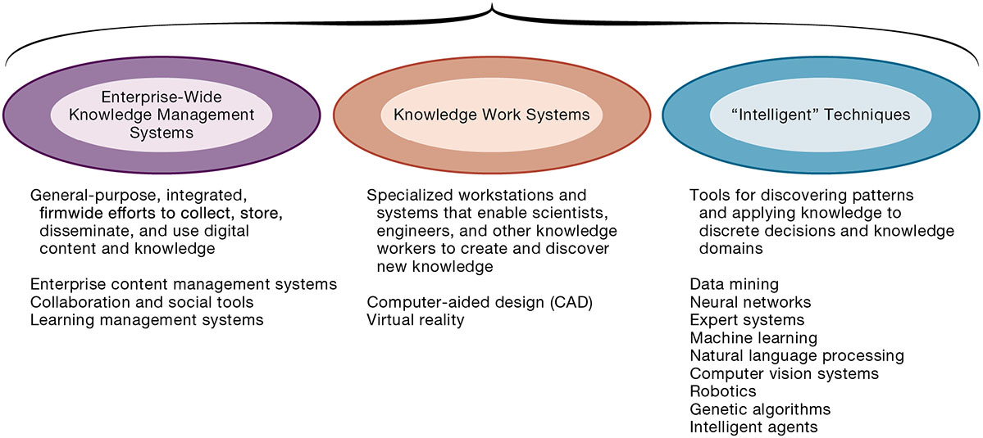
Figure 11.2 Major Types of Knowledge Management Systems
Notes:
Figure 11.2, Page 424.
There are three major categories of knowledge management systems, and each can be broken down further into more specialized types of knowledge management systems.
This graphic illustrates the three major types of knowledge management systems, giving the purpose of the system and examples of the type of system. Ask the students how they would categorize a system that catalogs and stores past advertising campaigns? What about software that helps a research biologist input and analyze lab findings?
Alt Text
Long description: An illustration explains three major types of knowledge management systems. The details are as below:
Enterprise-wide knowledge management systems: General-purpose, integrated, firm wide efforts to collect, store, disseminate, and use digital content and knowledge.
Enterprise content management systems
Collaboration and social tools
Learning management systems.
Knowledge works systems: Specialized workstations and systems that enable scientists, engineers, and other knowledge workers to create and discover new knowledge.
Computer-aided design (CAD)
Virtual reality.
Intelligent techniques: Tools for discovering patterns and applying knowledge to discrete decisions and knowledge domains.
Data mining
Neural networks
Expert systems
Machine learning
Natural language processing
Computer vision systems
Robotics
Genetic algorithms
Intelligent agents.

Slide 16
What Is Artificial Intelligence?
Artificial intelligence (AI): a form of intelligent technique
Grand vision
  Computer hardware and software systems that are as “smart” as humans
  So far, this vision has eluded computer programmers and scientists
Narrower, more realistic vision
  Systems that take data inputs, process them, and produce outputs (like all software programs) and that can perform many complex tasks that would be difficult or impossible for humans to perform.
Notes:
The grand vision of AI is very different from the reality of AI. You should point out to students that artificial intelligence is not the same as human intelligence. While there are many tasks currently performed by humans that can be performed by machines, and sometimes much better (faster, more comprehensive, etc.) than humans, human intelligence is much more generalized, and powerful in many respects. Google’s search engine does something humans cannot do: search several billion websites in response to a query in just milliseconds. Humans, however, know what to search for. There are self-driving cars, but they don’t know where to drive unless directed by a human being. The human brain contains an estimated 100 billion neural cells, each with over 10,000 synapse connections to other cells. It operates on 7 watts of energy (the entire body uses 25 watts). Currently, scientists do not understand how the brain works at the microbiological or neural level. There are no computing systems in the foreseeable future that will come close to this level of computing power. IBM’s Watson AI system used 200,000 watts of electricity when playing Jeopardy.
So try to dispel the popular ideas about AI or robots taking over the world! All of these techniques are useful tools, but not replacements for human intelligence. They generally amplify human intelligence.
.

Slide 17
Major Types of AI
Expert systems
Machine learning
Neural networks and deep learning networks
Genetic algorithms
Natural language processing
Computer vision
Robotics
Notes:
This slide lists the major types of AI. Each type is discussed in more detail in the following slides.

Slide 18
Expert Systems
Capture tacit knowledge in very specific and limited domain of human expertise
Capture knowledge as set of rules
Typically perform limited tasks
  Diagnosing malfunctioning machine
  Determining whether to grant credit for loan
Used for discrete, highly structured decision making
Knowledge base: Set of hundreds or thousands of rules
Inference engine: Strategy used to search knowledge base
  Forward chaining
  Backward chaining
Notes:
This slide describes expert systems, one type of intelligent technique. Ask students why expert systems are best used in highly structured decision-making situations. Ask students to provide an example of a decision that could not be solved by an expert system. Choice of music, potential spouses or mates, new product decisions, or designing a new marketing campaign might be good examples of poorly structured decision situations.
This slide also describes how expert systems work. Their key elements are their knowledge base and their inference engine. Ask students to demonstrate an understanding of the difference between forward chaining and backward chaining. For example, given a hypothesized expert system to determine what to make for dinner, what would an inference engine with forward chaining begin with? (Example, is there chicken? Is there beef? Is there broccoli, etc.? What are all the ingredients available and what could be made from them?) What would an inference with backward chaining begin with? (We are making chicken with broccoli. Do we have the ingredients?)

Slide 19
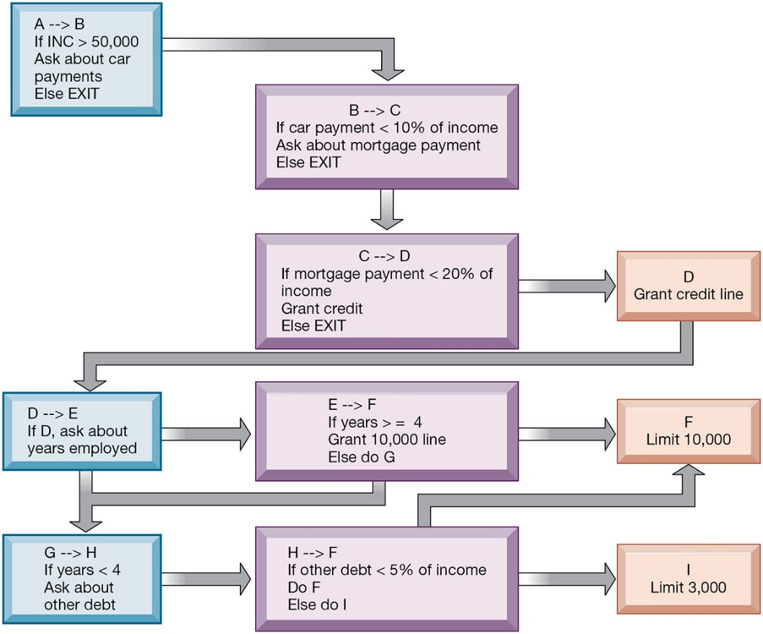
Figure 11.3 Rules in an Expert System
Notes:
Figure 11.3, Page 427.
An expert system contains a number of rules to be followed. The rules are interconnected, the number of outcomes is known in advance and is limited, there are multiple paths to the same outcome, and the system can consider multiple rules at a single time. The rules illustrated are for simple credit-granting expert systems.
This graphic illustrates the use of if/then rules in an expert system. Ask students to demonstrate an understanding of if/then rules, by analyzing a common decision as a series of if/then statements; for example, the decision to accept an invitation to socialize on a weeknight, or the decision of what to make for dinner.
Alt Text
Long description: A flowchart explains the rules in an expert system. The details of the expert system are as follows:
Process movement from stage A to stage B. If INC is greater than 50,000. Ask about car payments, else exit.
Process movement from stage B to stage C. If car payment is greater than 10% of income. Ask about mortgage payment, else exit.
Process movement from stage C to stage D. If mortgage payment is greater than 20% of income. Grant credit, else exit.
Stage D. Grant credit line, move to Stage E from stage D. If stage D, ask about years employed. Process moves from stage E to stage F or stage G to stage H.
Process movement from stage E to stage F. If years greater than or equal to 4 grant 10,000 line, else do G.
Stage F. Limit 10,000.
Process movement from stage G to stage H. If years less than 4. Ask about other debt.
Process movement from stage H to F. If other debt is greater than 5% of the income do F, else do I.
Stage I, limit 3000.

Slide 20
Machine Learning (1 of 2)
Used by neural networks, deep learning networks, and genetic algorithms
Different paradigm than expert systems
Focuses on recognizing patterns in very large data sets
Contemporary examples
  Facebook ad display
  Netflix recommender system
Notes:
Ask students if they have used Netflix’s or Amazon’s recommender systems. How well did the recommender systems help them find other products to buy or movies to watch?

Slide 21
Machine Learning (2 of 2)
Supervised learning
  System “trained” by providing examples of desired inputs and outputs identified by humans in advanced
  One technique used to develop autonomous vehicles
Unsupervised learning
  Same procedures as used with supervised learning, but humans do not provide examples
  “Cat Paper”

Slide 22
Neural Networks (1 of 3)
Find patterns and relationships in massive amounts of data too complicated for humans to analyze
“Learn” patterns by searching for relationships, building models, and correcting over and over again
Humans “train” network by feeding it data inputs for which outputs are known, to help neural network learn solution by example from human experts
Used in medicine, science, and business for problems in pattern classification, prediction, financial analysis, and control and optimization
Notes:
This slide discusses neural networks. Ask students whether neural networks could be used in medical diagnosis? How would this work? To some extent, data mining techniques have replaced neural networks in situations requiring pattern recognition. For instance, credit card companies sift through mountains of transaction data to identify which charging patterns are unlikely for each and every charge card customer.

Slide 23
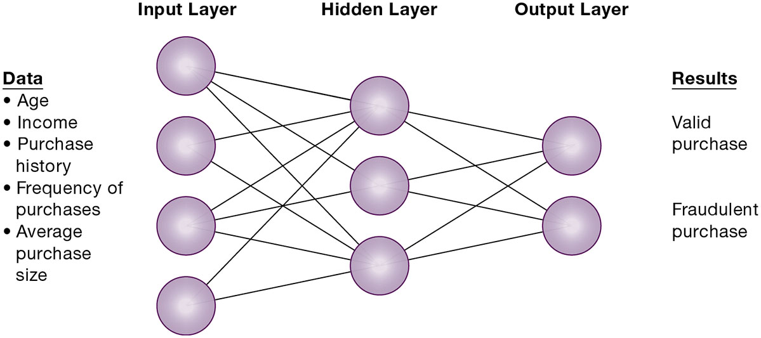
Figure 11.4 How a Neural Network Works
Notes:
Figure 11.4, Page 430.
A neural network uses rules it “learns” from patterns in data to construct a hidden layer of logic. The hidden layer then processes inputs, classifying them based on the experience of the model. In this example, the neural network has been trained to distinguish between valid and fraudulent credit card purchases.
This graphic illustrates how a neural network works—by using an internal, hidden layer of logic that examines existing data and assigning a classification to that set of data. For example, given one or more specific combinations of age, income, purchase history, frequency of purchases, and average purchase size, a neural network might determine that a new credit card purchase was likely to be fraudulent. What are the benefits and drawbacks of using this type of technique?
Alt Text
Long description: A neural network diagram explains how data from various layers gives results. The details are as below:
Data like age, income, purchase history, frequency of purchases, and average purchase size passes through the nodes of input layers.
These nodes are interconnected to various nodes in the hidden layer. These nodes are interconnected to the nodes in the output layer to give results. There are four nodes in the output layer, three in the hidden layer, and two in output layer.
The results include valid and fraudulent purchases.

Slide 24
Interactive Session: Technology: Do You Know Who Is Using Your Face?
Class discussion
  Explain the key technologies used in facial recognition systems.
  What are the benefits of using facial recognition systems. How do they help organizations improve operations and decision making. What problems can they help solve?
  Identify and describe the disadvantages of using facial recognition systems and facial databases.

Slide 25
Neural Networks (2 of 3)
Deep learning neural networks
  More complex, with many layers of transformations of input data to produce target output
  Used almost exclusively for pattern detection on unlabeled data (unsupervised learning)
  Some believe these come closest to “grand vision” of AI

Slide 26
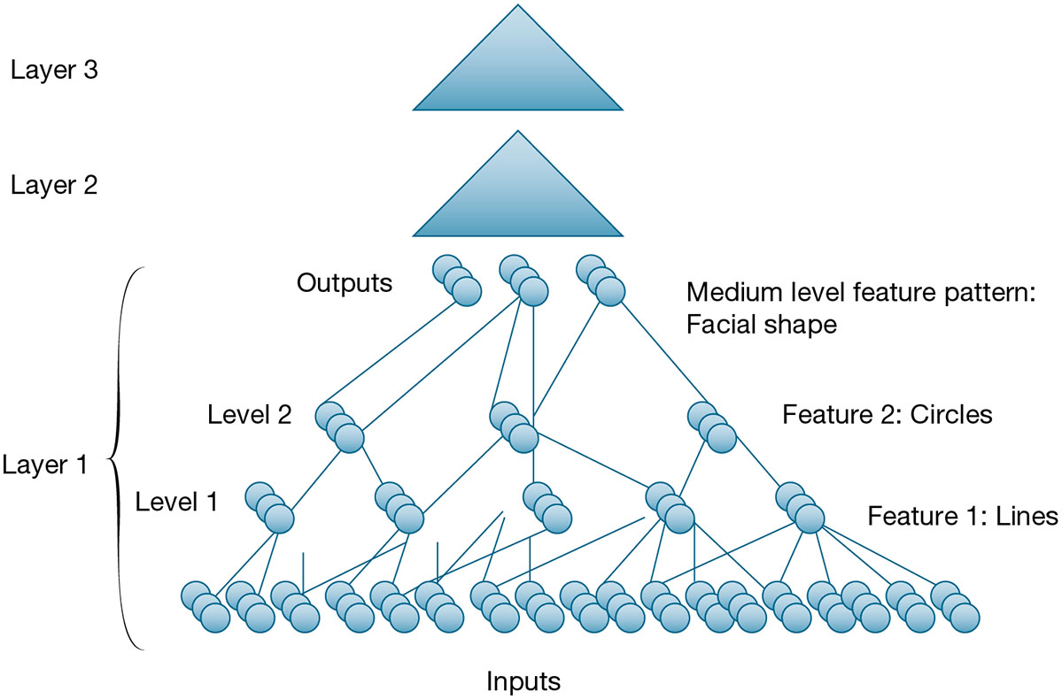
Figure 11.5 A Deep Learning Network
Notes:
Figure 11.5, Page 433.
Deep learning networks consist of many layers of neural networks working in a hierarchical fashion to detect patterns. Shown here is an expanded look at layer 1. Other layers have the same structure.
Alt Text
Long description: An illustration explains an exploded view of a 3-layered neural network diagram. The details from top-down are as follows:
Layer 3 and layer 2 resemble two equilateral triangles.
Layer 1 consists of several nodes and connectors. The nodes are depicted by circles and the connectors are depicted by lines.
At the input level several nodes are connected to the nodes in level 1. The feature here is lines. Similarly, the nodes in level 1 are connected to the nodes in level 2. The feature here is circles. At the output level the nodes from the level 2 connect to the nodes in the output level. Medium level feature pattern is facial shape at this level.
The nodes appear to be declining at each level, while appearing to take the shape of a triangle.

Slide 27
Neural Networks (3 of 3)
Limitations of neural networks and machine learning
  Require very large data sets to identify patterns
  Patterns may not “make sense: or may be ephemeral
  How system arrived at a particular solution often cannot be explained
  Most useful for classifying digital assets into binary categories (yes or no), but most real-world problems do not have binary solutions
  No sense of ethics, so may recommend actions that are illegal or immoral

Slide 28
Genetic Algorithms
Useful for finding optimal solution for specific problem by examining very large number of possible solutions for that problem
Conceptually based on process of evolution
  Search among solution variables by changing and reorganizing component parts using processes such as inheritance, mutation, and selection
Used in optimization problems (minimization of costs, efficient scheduling, optimal jet engine design) in which hundreds or thousands of variables exist
Able to evaluate many solution alternatives quickly
Notes:
This slide discusses another type of intelligent technique—genetic algorithms. Ask students whether genetic algorithms might be useful in medical diagnosis. Why or why not? Ask students to differentiate between the various intelligent techniques discussed this far—expert systems, neural networks, and genetic algorithms.

Slide 29
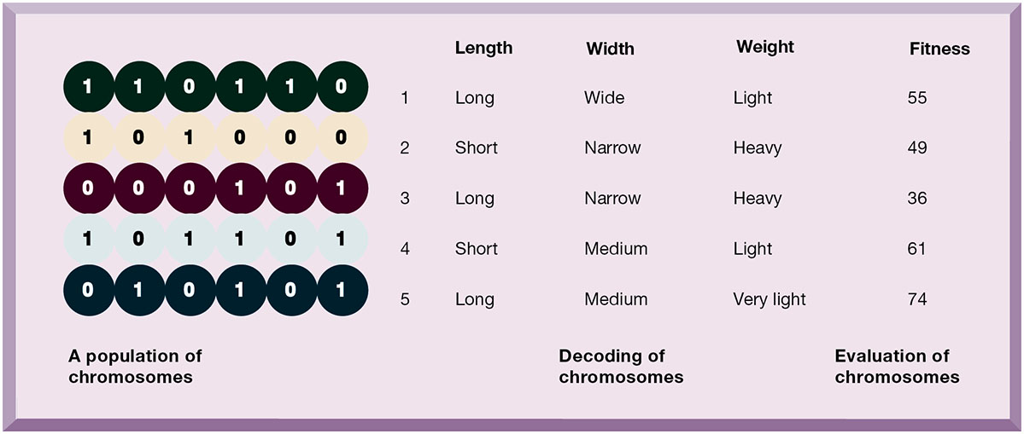
Figure 11.6 The Components of a Genetic Algorithm
Notes:
Figure 11.6, Page 434.
This example illustrates an initial population of “chromosomes,” each representing a different solution. The genetic algorithm uses an iterative process to refine the initial solutions so that the better ones, those with the higher fitness, are more likely to emerge as the best solution.
This graphic illustrates the components of a genetic algorithm—“chromosomes”, each with a variety of characteristics that can be compared for overall fitness in a given situation. Ask students what types of problems genetic algorithms are suited for.
Alt Text
Long description: An illustration explains the concept of a genetic algorithm. The details pertaining to the population, decoding, and evaluation of chromosomes is given below:
110110: Length, long; Width, wide; Weight, light; Fitness, 55.
101000: Length, short; Width, narrow; Weight, heavy; Fitness, 49.
000101: Length, long; Width, narrow; Weight, heavy; Fitness, 36.
101101: Length, short; Width, medium; Weight, light; Fitness, 61.
010101: Length, long; Width, medium; Weight, very light; Fitness, 74.

Slide 30
Natural Language Processing
Software that can process voice or text command using natural human language
Typically based on machine learning, including deep learning
Examples: Google search; spam filtering systems; text mining sentiment analysis; customer call center interactions
Notes:
Ask students to describe their experiences using digital assistants like Siri, Alexa, or Cortana.

Slide 31
Computer Vision Systems
Emulate human visual system to view and extract information from real-world images
Examples:
  Facebook’s DeepFace can identify friends in photos across their system and the entire web
  Autonomous vehicles can recognize signs, road markers, people, animals, and other vehicles with good reliability
Notes:
Can computer vision systems detect an imposter using makeup, or a recently grown beard? Or when people age and their faces change, can they be recognized by a computer vision system?

Slide 32
Robotics
Design, construction, and operation of movable machines that can substitute for humans, along with computer systems for their control, sensory feedback, and information processing
Generally programmed to perform specific and detailed actions in limited domains, e.g. robots spray paint autos, and assemble certain parts, welding, heavy assembly movement
Used in dangerous situations like bomb disposal, delivering medical supplies to coronavirus-contaminated locations
Surgical robots are expanding their capabilities
Notes:
Ask students to recount any experiences they have had with robots in industry or in their homes.

Slide 33
Interactive Session: Organizations: Will AI Kill Jobs?
Class discussion
  Identify the problem described in this case study. In what sense is it an ethical dilemma?
  Should more tasks be given to AI? Why or why not? Explain your answer.
  Can the problem of AI reducing employment be solved? Explain your answer.

Slide 34
Intelligent Agents
Work without direct human intervention to carry out repetitive, predictable tasks
  Deleting junk e-mail
  Finding cheapest airfare
Use limited built-in or learned knowledge base
  Some are capable of self-adjustment, for example: Siri
Chatbots
Agent-based modeling applications:
  Model behavior of consumers, stock markets, and supply chains; used to predict spread of epidemics
Notes:
This slide discusses the use of intelligent agents to carry out repetitive tasks for a user or system. Shopping bots are an example of an intelligent agent. As an example of agent-based modeling, Procter & Gamble used agent-based modeling to improve coordination among supply-chain members. Siri, Apple’s “intelligent assistant,” is an example of a software program that can assist users in searching for content and answers to questions with a natural language interface. How many students have used Siri? What for?

Slide 35
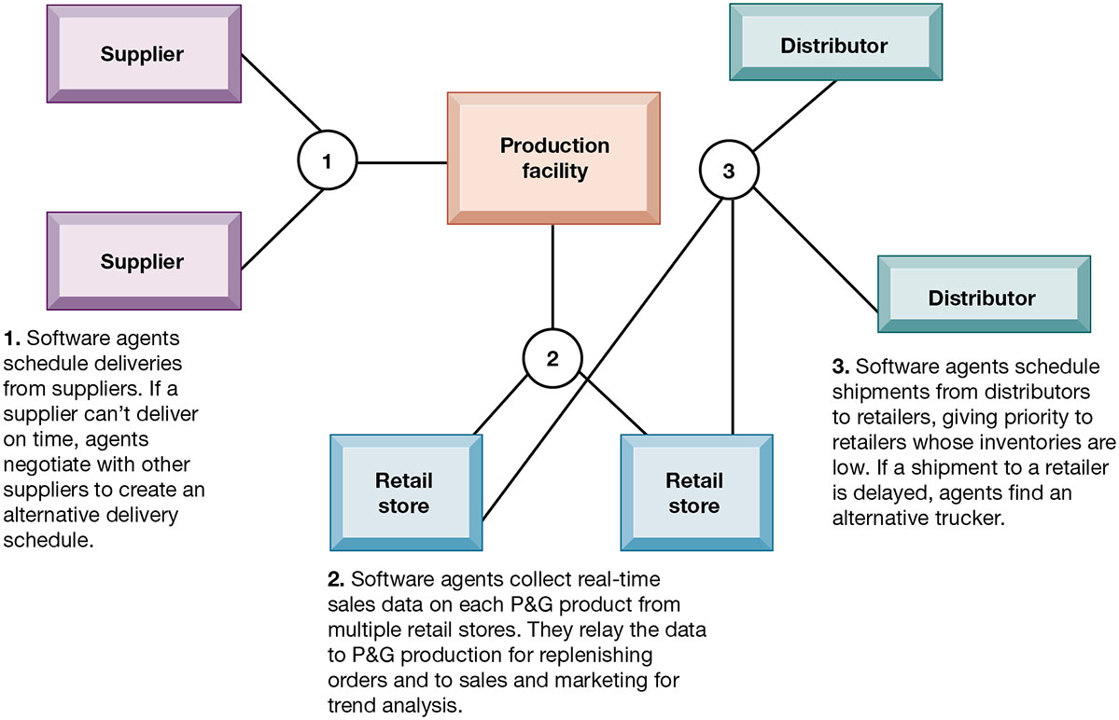
Figure 11.7 Intelligent Agents in P&G’s Supply Chain Network
Notes:
Figure 11.7, Page 439.
Intelligent agents are helping P&G shorten the replenishment cycles for products such as a box of Tide.
This graphic illustrates Procter & Gamble’s use of intelligent agents in its supply chain network. Given that intelligent-agent modeling mimics the behavior of a number of “actors” in a given situation, what other types of situations might benefit from this type of analysis?
Alt Text
Long description: An illustration explains how software agents support in shortening the replenishment cycle. The supply chain of Proctor & Gamble is as follows:
The production facility is connected to various suppliers. Software agents schedule deliveries from suppliers. If a supplier can’t deliver on time, agents negotiate with other suppliers to create an alternative delivery schedule.
The production facility is also connected to various retail stores. Software agents collect real-time sales data on each P&G product from multiple retail stores. They relay the data to P&G production for replenishing orders and to sales and marketing for trend analysis.
The retail store is connected to the distributor. Software agents schedule shipments from distributors to retailers, giving priority to retailers whose inventories are low. If a shipment to a retailer is delayed, agents find an alternative trucker.

Slide 36
What Types of Systems Are Used for Enterprise-Wide Knowledge Management?
Three major types of knowledge in an enterprise
  Structured documents
    Reports, presentations
    Formal rules
  Semistructured documents
    E-mails, videos
  Unstructured, tacit knowledge
80% of an organization’s business content is semistructured or unstructured
Notes:
This slide describes the three major kinds of knowledge that can be found in an enterprise and indicates that less formal knowledge may be just as critical as formal knowledge for organizations to store and share. Ask the students for other examples of semistructured and unstructured knowledge. Ask students for an example of tacit knowledge that is more important than structured knowledge such as a report.

Slide 37
Enterprise Content Management Systems
Help capture, store, retrieve, distribute, preserve documents and semistructured knowledge
Bring in external sources
  News feeds, research
Tools for communication and collaboration
  Blogs, wikis, and so on
Key problem: developing taxonomy
Digital asset management systems
Notes:
This slide discusses the purpose and features of enterprise-wide content management systems. A first step in building such systems is describing a knowledge object (document) so that it can be found later by users. Companies must decide and implement classification schemes, or taxonomies, to define categories meaningful to users, and then knowledge objects must be assigned a classification (“tagged”) so that it can be retrieved. Ask students why different companies might need different taxonomies? Why is it a critical task and a difficult task in preparing for a successful content management system? Some content management systems specialize in managing digital media storage and classification. What types of firms may need these digital asset management systems? (publishers, advertisers, law firms, broadcasters, entertainment producers, etc.)

Slide 38
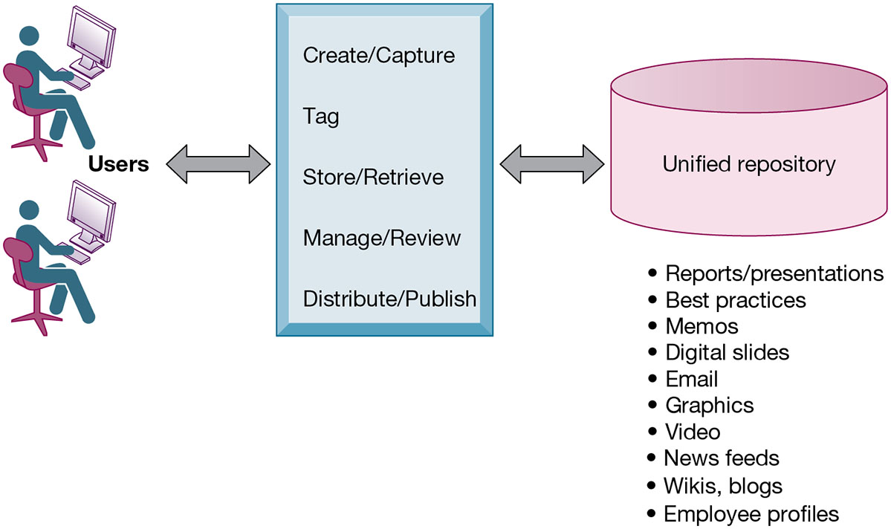
Figure 11.8 An Enterprise Content Management System
Notes:
Figure 11.8, Page 440.
An enterprise content management system has capabilities for classifying, organizing, and managing structured and semistructured knowledge and making it available throughout the enterprise.
This graphic illustrates the functions of an enterprise content management system. Users interact with the system to both input knowledge, manage it, and distribute it. These management systems can house a wide variety of information types, from formal reports to graphics, as well as bring in external content resources such as news feeds. Ask students what types of documents would need to be stored by a hospital, bank, law firm, and so on.
Alt Text
Long description: A linear flow diagram explains the concept of an enterprise content management system. The linear flow is as follows:
The users are connected to the various processes, and these processes are in turn connected to a unified repository.
The processes outlined in this flow diagram are:
Create or Capture
Tag
Store or Retrieve
Manage or Review
Distribute or Publish.
The repository includes the following:
Reports/presentations
Best practices
Memos
Digital slides
Email
Graphics
Video
News feeds
Wikis, blogs
Employee profiles.
The connection in the diagram is depicted by bidirectional arrows.

Slide 39
Locating and Sharing Expertise
Provide online directory of corporate experts in well-defined knowledge domains
Search tools enable employees to find appropriate expert in a company
Social networking and social business tools for finding knowledge outside the firm
  Saving
  Tagging
  Sharing web pages
Notes:
Enterprise content management systems can include or consist of capabilities for the creation and management of unstructured knowledge. Ask the students to give examples of unstructured knowledge, given a type of industry or company: a law firm, an advertising firm, a school. What might be the difficulties in locating expertise in these firms? Contrast this network (crowd-centered) approach to a top-down structured knowledge management system.

Slide 40
Learning Management Systems (L M S)
Provide tools for management, delivery, tracking, and assessment of employee learning and training
Support multiple modes of learning
  web-based classes, online forums, and so on
Automates selection and administration of courses
Assembles and delivers learning content
Measures learning effectiveness
Massively open online courses (M O O C s)
  Web course open to large numbers of participants
Notes:
This slide discusses learning management systems, which enable companies to track and manage employee learning. Ask students what are the benefits and drawbacks of using an LMS with centralized reporting.

Slide 41
Knowledge Workers and Knowledge Work
Knowledge workers
  Researchers, designers, architects, scientists, engineers who create knowledge for the organization
  Perform key roles critical to organization and managers who work within organization
Knowledge work systems
  Systems for knowledge workers to help create new knowledge and integrate that knowledge into business
Notes:
This slide discusses knowledge work systems and identifies the importance of knowledge workers to an organization and its knowledge creation. Ask the students how knowledge workers can benefit an organization. Can all companies benefit from knowledge workers, or only design, science, and engineering firms?

Slide 42
Requirements of Knowledge Work Systems
Sufficient computing power for graphics, complex calculations
Communications and document management
Access to external databases
User-friendly interfaces
Optimized for tasks to be performed (design engineering, financial analysis)
Notes:
This slide continues the discussion of knowledge work systems, emphasizing the need of knowledge workers to have highly specialized knowledge work systems. Ask students to describe the reasons that these characteristics are important for a knowledge work system. What other types of information systems would a knowledge worker rely on, if any? (office systems, productivity systems, scheduling systems)

Slide 43
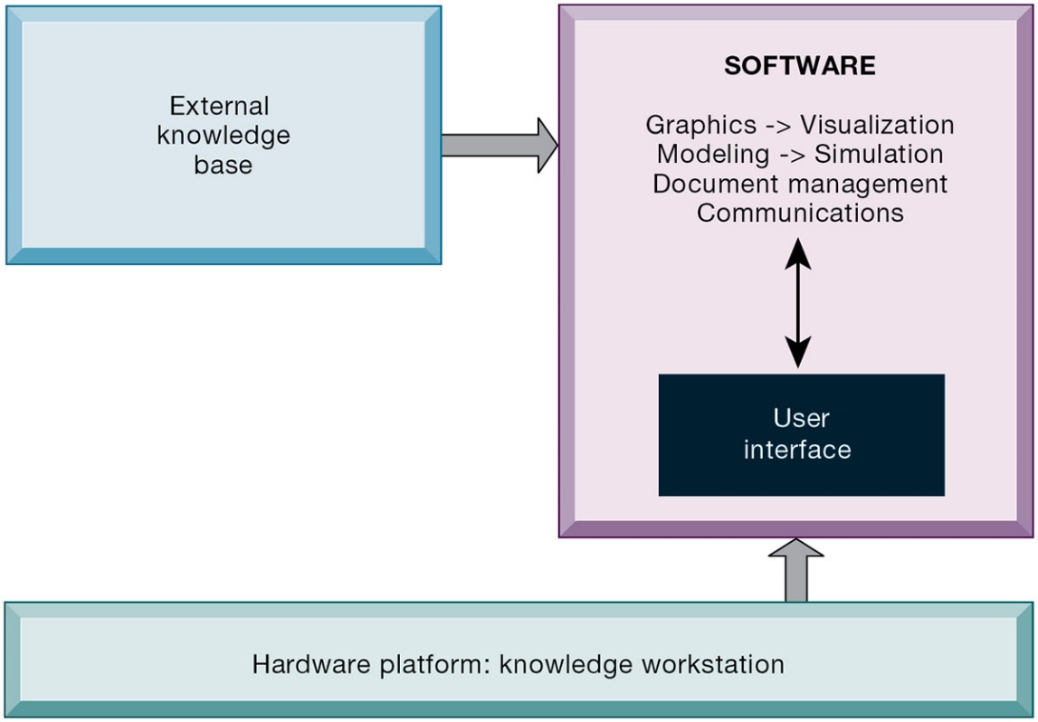
Figure 11.9 Requirements of Knowledge Work Systems
Notes:
Figure 11.9, Page 443.
Knowledge work systems require strong links to external knowledge bases in addition to specialized hardware and software.
This graphic illustrates the main components of a knowledge workstation: having the need for both specialized software and hardware, access to external information, and an easy-to-use interface. What types of external knowledge might be valuable to an engineer, a financial analyst, a medical researcher?
Alt Text
Long description: An illustration explains the requirements of knowledge work systems. The external knowledge base and hardware platform are connected to the software. The software includes processes like:
Graphics to Visualization
Modeling to Simulation
Document management
Communications
All these processes are interconnected to user interface. The hardware platform includes the knowledge workstation.

Slide 44
Examples of Knowledge Work Systems
C A D (computer-aided design)
  Creation of engineering or architectural designs
  3D printing
Virtual reality systems
  Simulate real-life environments
Augmented reality (AR) systems
  Enhance visualization by overlaying digital data and images onto physical real-world environment
Notes:
This slide describes types of knowledge work systems: CAD systems, virtual reality systems, and augmented reality (AR) systems. Ask students what the business value of providing a financial analyst, engineer, or researcher with an improved, specialized workstation would be. Can the value of implementing or upgrading work systems be quantified into a monetary value?
Note that augmented reality (AR) is a related technology for enhancing visualization. AR provides a live direct or indirect view of a physical real-world environment whose elements are augmented by virtual computer-generated imagery. The user is grounded in the real physical world, and the virtual images are merged with the real view to create the augmented display. What other industries might benefit from the use of virtual reality systems by their knowledge workers?

Slide 45
How Will MIS Help My Career?
The Company: RazzleDazzle Technology
Position Description: Entry-level sales assistant
Job Requirements
Interview Questions
Author Tips
Notes:
A good opportunity for a class discussion of the section on careers. Would any in the class be interested in a job like this? What do they think are the most important skills the employer is looking for? How would they answer the interviewer questions?

Slide 46

Copyright
This work is protected by United States copyright laws and is provided solely for the use of instructors in teaching their courses and assessing student learning. Dissemination or sale of any part of this work (including on the World Wide Web) will destroy the integrity of the work and is not permitted. The work and materials from it should never be made available to students except by instructors using the accompanying text in their classes. All recipients of this work are expected to abide by these restrictions and to honor the intended pedagogical purposes and the needs of other instructors who rely on these materials.

